Slide 1
In-class Exercise 04
Dhiren Gupta
800902466

Slide 2
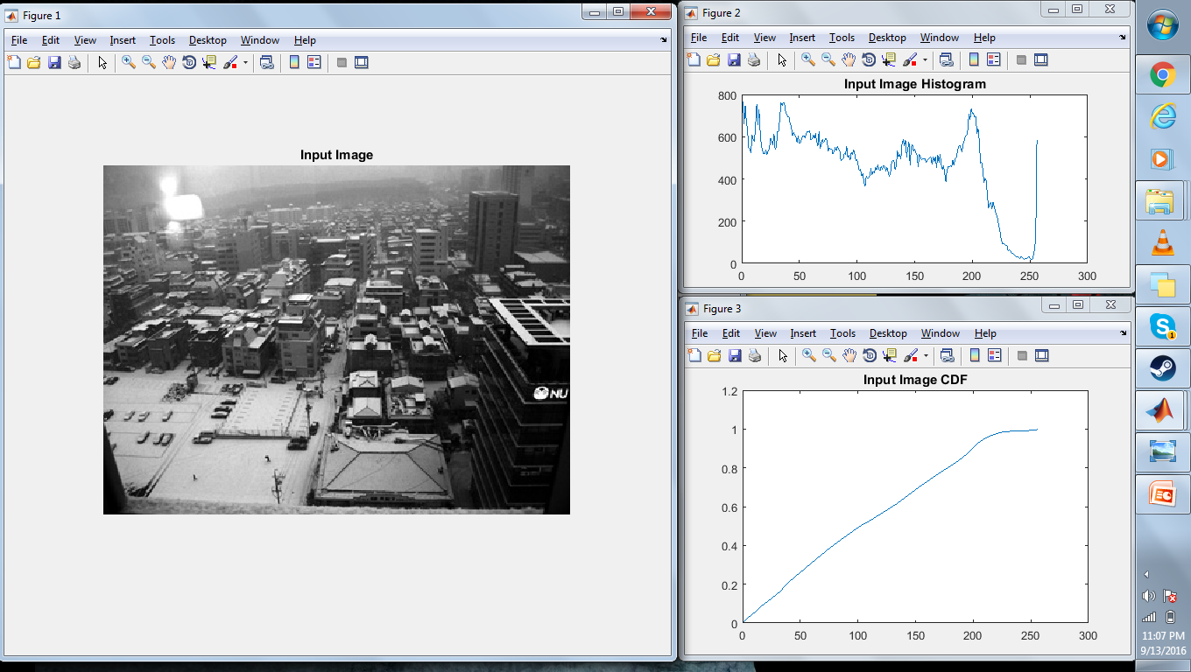
Input image, histogram and CDF

Slide 3
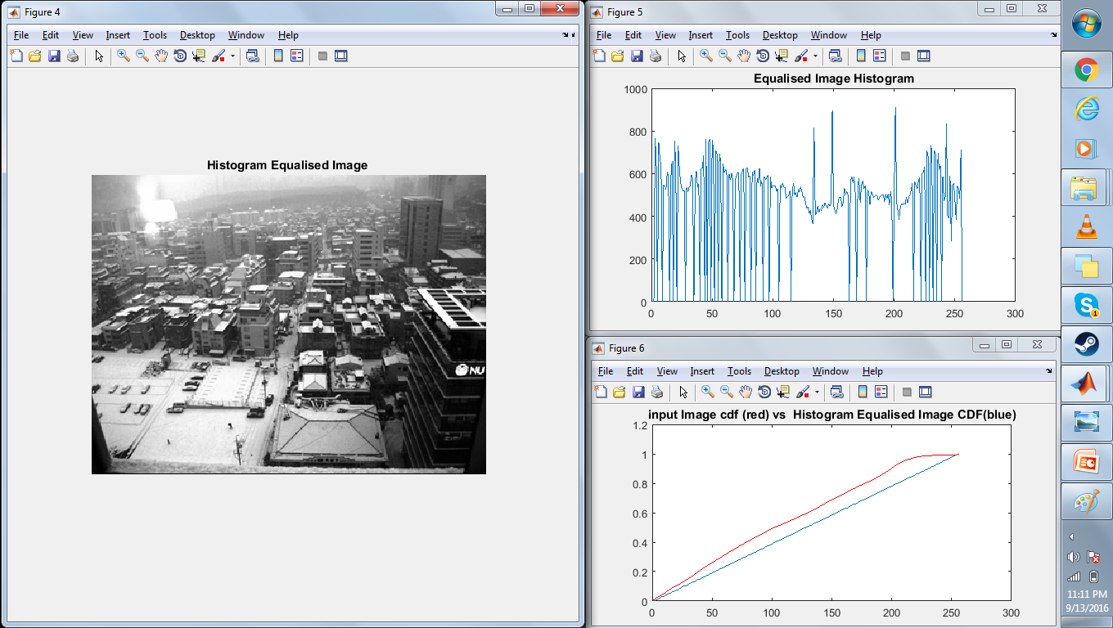
histogram equalized image, histogram and CDF

Slide 4
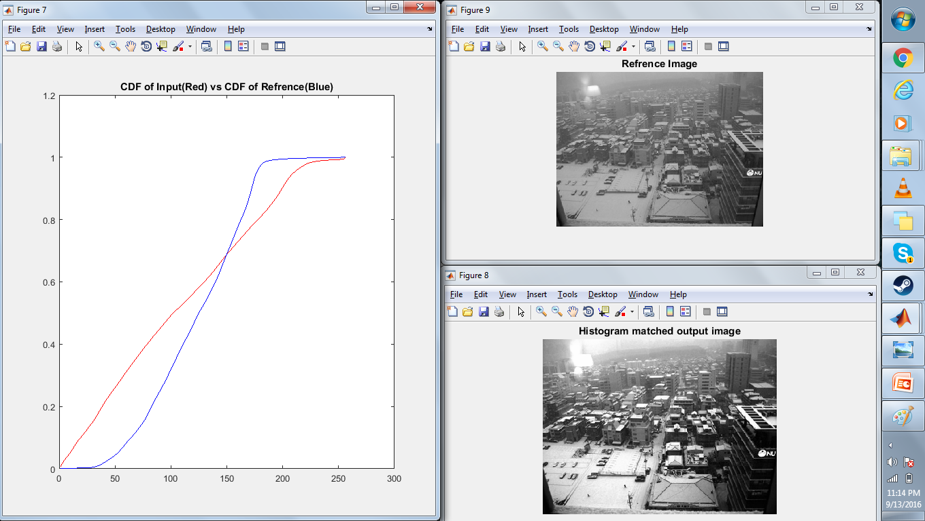
Reference image, histogram matched output image

Slide 5
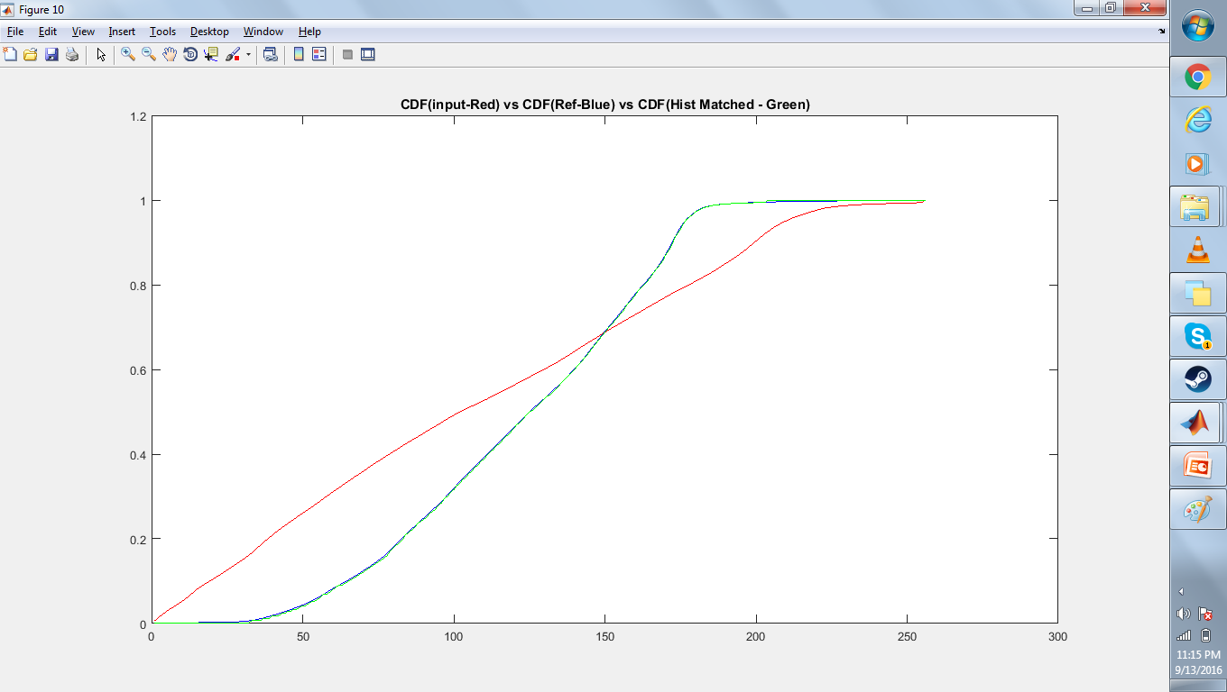
Final Result

Slide 6
Thank You

